Slide 1

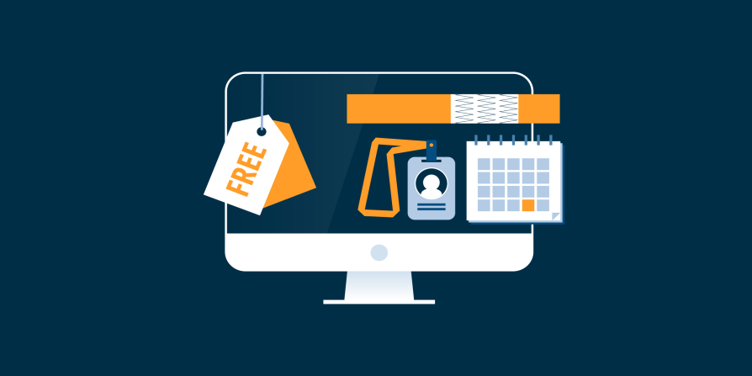
Event Registration Tracker Website
Team Anonymous
Members-
Tarun Gupta
Aniket Singhal
Avneet Singh

Slide 2
Introduction
Purpose
Provide an intuitive platform for creating, managing, and tracking event registrations.
Facilitate easy RSVPs and efficient organization of event details.
Scope
Event creation and management.
User registration and RSVP functionality.
Attendee tracking and notification system.
User feedback and review platform.
Audience
Event organisers, attendees, and administrators.

Slide 3
Overall Description
Product Perspective
A web-based application accessible via modern browsers.
User-friendly interfaces for both organisers and attendees.
Product Functions
Event management (create, update, delete events).
Registration management (allow users to register, update, cancel).
Attendee tracking (monitor attendee lists, send reminders).
Feedback system (collect and display user reviews).

Slide 4
Workflow Overview
Registration Process:
Attendee visits the registration page.
Fills out the customized form.
Receives confirmation email.
Organizer tracks registrations in real-time

Slide 5
What is an Event Registration Tracker?
An Event Registration Tracker is a tool or system used to manage and monitor the registration process for events, such as conferences, workshops, or social gatherings. It helps organizers keep track of attendees, manage ticket sales, and gather important information.

Slide 6
Importance of Event Registration
Efficient Data Collection: Captures attendee information seamlessly.
Enhanced Communication: Keeps attendees informed through automated notifications.
Simplified Check-in: Streamlines the check-in process on the event day.
Better Planning: Provides insights for improved event organization.

Slide 7
Functional Requirements
User Registration and Login
Users can create accounts and log in/out.
Event Management
Create, update, delete events with details like title, date, location, and description.
Registration and RSVP
Users can view events, register, provide additional info, and cancel registrations.
Attendee Tracking
View registered attendees, send confirmation and reminder emails.
Feedback System
Users can submit feedback and ratings for events.

Slide 8
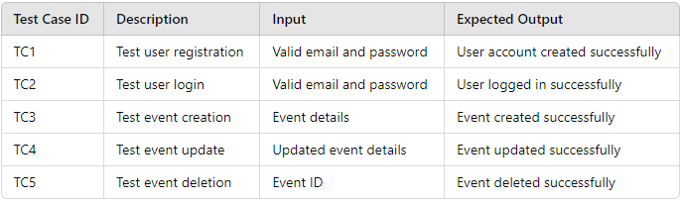
Testing Requirements
Testing Strategy
Conduct unit testing, integration testing, and user acceptance testing.
Test Cases Overview

Slide 9
Creative Features and Suggestions
Event Reminder System
Personalized reminder intervals (e.g., 1 day, 3 days before the event).
QR Code for Registration
Unique QR codes for check-in at events.
Social Media Integration
Share registrations on social media to increase visibility.
Custom Event Themes
Organisers can choose themes for event page designs.
Gamification
Points system for early registration, feedback, and sharing events.

Slide 10
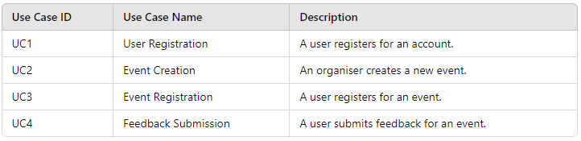
Use Cases

Slide 11
Datasets
Participants Dataset
Stores participant details for registration and management.
Events Dataset
Contains event information for listing and registration.
Registrations Dataset
Tracks participant registrations and comments.
Feedback Dataset
Stores feedback and ratings for post-event analysis.

Slide 12
Integration in the System
Registering Participants
Add participant info to the Participants dataset.
Displaying Event Listings
Show available events using the Events dataset.
Managing Event Registration
Record new registrations in the Registrations dataset.
Post-Event Feedback
Store feedback in the Feedback dataset for analysis.

Slide 13
Conclusion
Comprehensive Tool
The Event Registration Tracker enhances event management for organisers and attendees.
Streamlines the registration process with user-friendly features and creative aspects.

